Slide 1


Project Title: Solving the Viscous Burger's Equation Using Physics-Informed Neural Networks(PINNs)
Professor:
Dr. Jiaqi Gong
Department of Computer Science
GitHub Repository link: Solving-Viscous-Burgers-Equation-Using-PINNs
YouTube Presentation link:
Presented by:
Tharun Chowdary Malepati
tmalepati@crimson.ua.edu
CS-691(Deep Generative Modeling for Physical Processes)

Slide 2
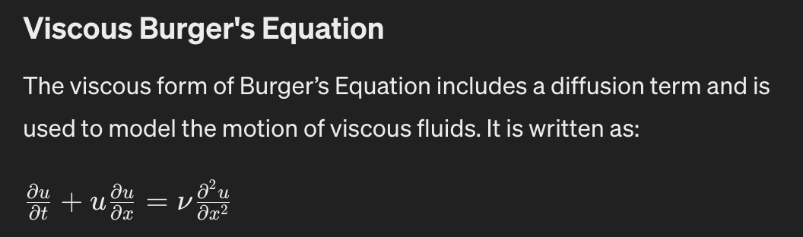
Viscous Burger’s Equation
It captures essential behaviors of fluids, including wave propagation, shock wave formation, and the smoothing effect of viscosity, making it a pivotal tool in fluid mechanics, applied mathematics, and computational modeling
It is mainly used to model both advection and diffusion for fluid flow.
It provides a more accurate representation of real fluid behavior, especially over longer timescales where diffusion plays a significant role.
ν is the kinematic viscosity of the fluid, which controls the diffusion rate.

Slide 3
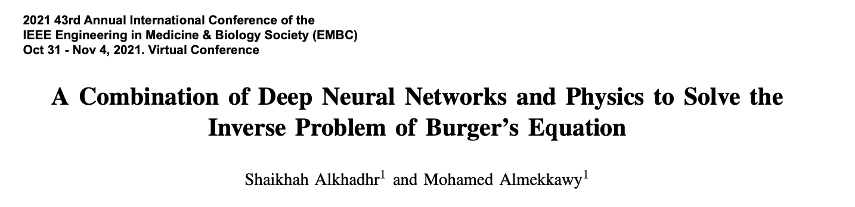
Motivation and background work:
A combination of deep Neural Networks and physics to solve the inverse problem of Burger's equation

Slide 4
Abstract:
We have developed a novel method for solving the viscous Burgers' equation using PINNs.
Innovative Approach of Integrating core physical laws with extensive data within the neural network architecture.
We have Enabled networks to adhere to fluid dynamics' differential equations, ensuring high accuracy under complex conditions.
We achieved significant improvements in prediction accuracy and computational efficiency compared to traditional methods.
This work laid the groundwork for advanced machine-learning applications in fluid dynamics and other scientific fields.

Slide 5
Introduction:
1. Fluid Dynamics Introduction:
Study of movement in liquids and gases.
Essential for engineering and environmental sciences.
2. Burgers' Equation Significance:
A key model for phenomena like shock waves and boundary layers.
Complexity increases with fluid viscosity.
3. Challenges with Viscous Version:
Difficult to solve due to nonlinear behaviors and sensitivity to conditions.
Traditional methods often fall short in accuracy.

Slide 6
Cont.…
4. Advantages of PINNs:
It combines machine learning with physical laws.
Enhances prediction accuracy and computational efficiency.
5. Research Objective:
Implement PINNs to address the viscous Burgers' equation.
Aim to improve fluid modeling techniques across various applications.

Slide 7
Literature Review:
1. Integration of ML in Fluid Dynamics:
Machine learning, especially Physics-Informed Neural Networks (PINNs), is revolutionizing the solution of complex fluid dynamics equations.
2. Capabilities of PINNs:
These networks incorporate physical laws into their structure, ensuring solutions are realistic and adhere to physical principles.
3. Research Developments:
PINNs have improved in efficiency and accuracy, better handling complex scenarios like nonlinear PDEs and boundary conditions.
4. Performance Advantage:
Studies show that PINNs outperform traditional methods in scalability and computational efficiency, especially in high-dimensional spaces.

Slide 8
Problem Selection:
1. Importance of Viscous Burgers' Equation:
A fundamental equation in fluid mechanics that models essential phenomena such as shock waves and traffic flow.
2. Complexity and Challenges:
The equation features nonlinear advection and diffusion, presenting significant challenges in traditional numerical simulations.
3. Choice Justification:
Ideal for testing PINNs' capabilities due to its non-linear and diffusion-dominated nature, enhancing understanding of fluid dynamics.
4. Goal of Research:
To improve prediction and analysis of complex fluid behaviors using PINNs, demonstrating their potential for broader applications in fluid dynamics.

Slide 9
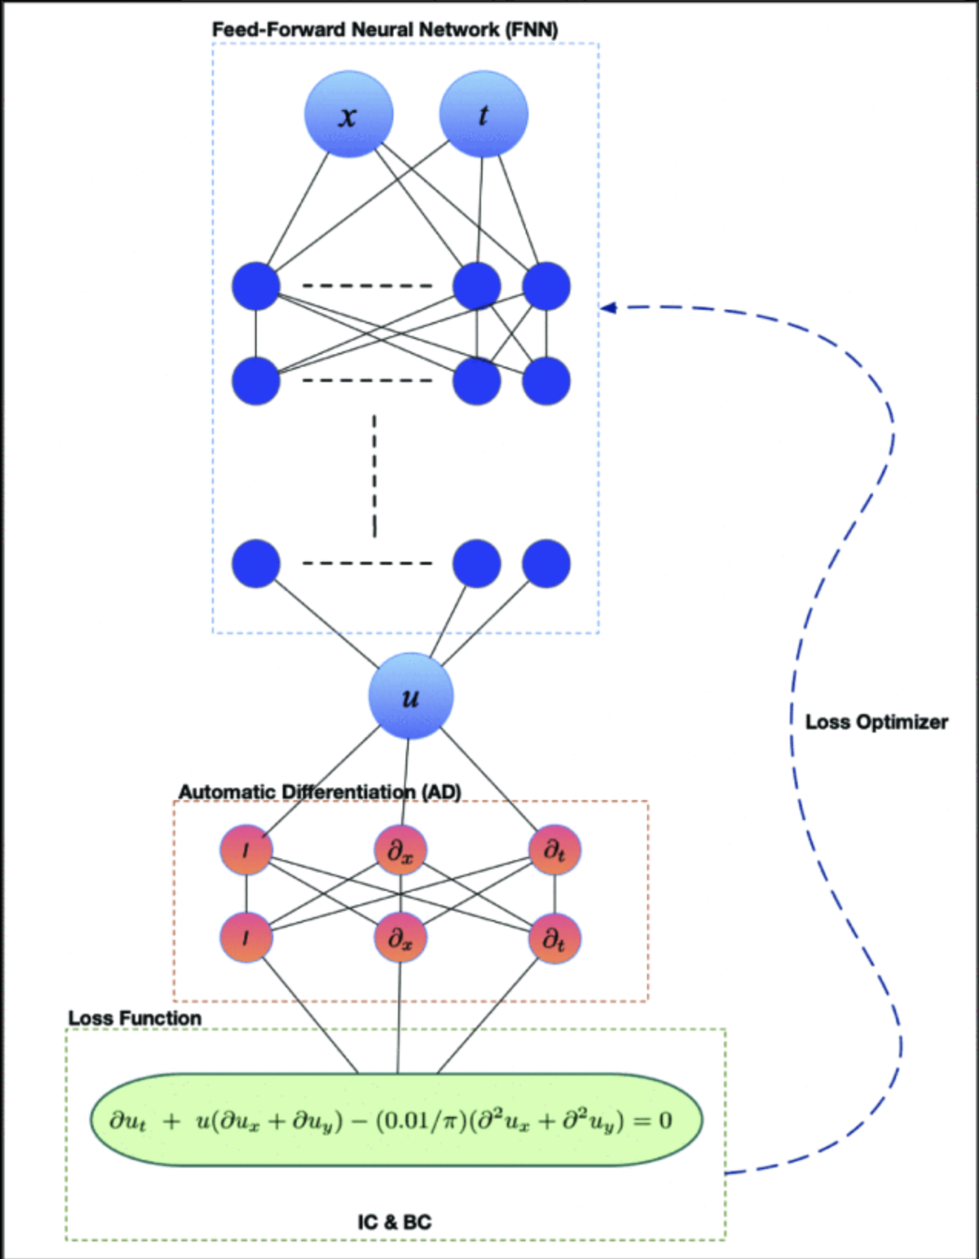
Methodology:
Work-flow of the model:
1. Feed-Forward Neural Network Configuration
2. Automatic Differentiation (AD)
3. Loss Function
4. Loss Optimizer

Slide 10
Cont..
1)Feed-Forward Neural Network (FNN) Configuration:
Input Layer:
Utilizes spatial (x) and temporal (t) coordinates as inputs, which are the independent variables of the Burgers' equation.
Output Layer:
Generates predicted solutions 𝑢u, representing fluid velocity at the input coordinates.
Purpose:
The FNN aims to approximate the function 𝑢(𝑥,𝑡)u(x,t), governed by the Burgers' equation.

Slide 11
Cont...
2)Automatic Differentiation (AD):
Implementation:
Uses TensorFlow to efficiently compute derivatives of the predicted solution 𝑢u concerning inputs 𝑥x and 𝑡t.
Role in Loss Function:
These derivatives are crucial for accurately representing the differential component of the Burgers' equation in the loss function.

Slide 12
Cont…
3) Loss Function:
Mathematical Formulation:
“𝑢” is the velocity field
“𝜈” is the kinematic viscosity
“𝑡” is time
“𝑥” is the spatial coordinate
Objective:
Minimize this loss to ensure the solution adheres to both the viscous Burgers' equation and the prescribed initial/boundary conditions.

Slide 13
Cont…
4) Loss Optimizer:
Algorithm:
L-BFGS was chosen for its effectiveness in handling complex loss functions typical in PINNs.
Functionality:
It Updates network parameters by computing gradients of the loss and adjusting parameters to minimize the loss.
Goal:
Teach the network to accurately approximate the solution to the viscous Burgers’ equation.

Slide 14
Code-file Walk through:
Environment Setup and Data Import
Data Preparation
Boundary and Initial Conditions Setup
Neural Network Model Definition
Loss Functions and Optimization
Training Process and Callbacks
Model Evaluation
Results
Model Visualization

Slide 15
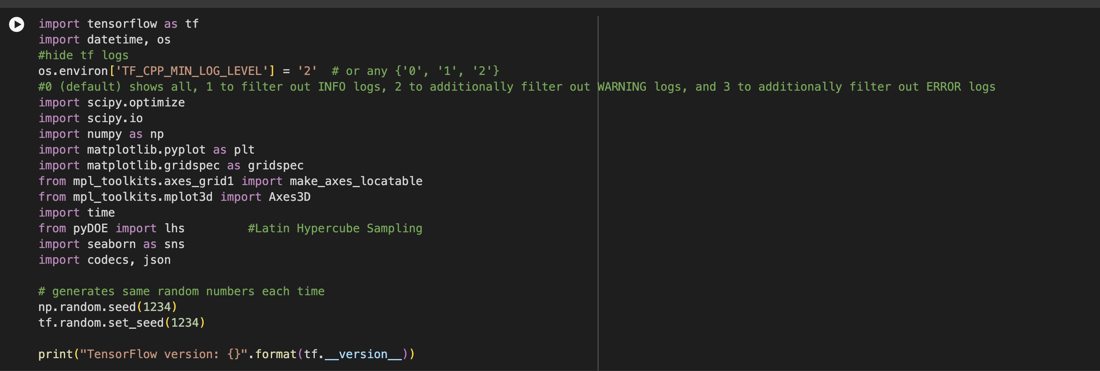
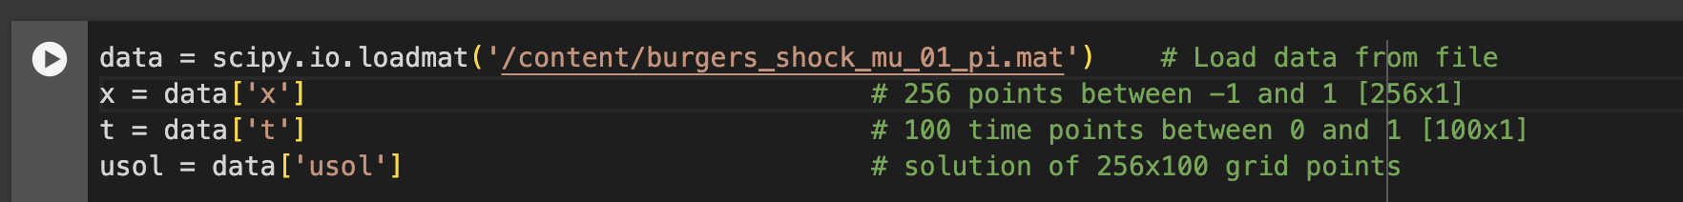
1)Environment Setup and Data Import:
Importing necessary libraries and modules.
Setting up a TensorFlow environment to control logging levels.
Loading and parsing the dataset from a “.mat” file.

Slide 16
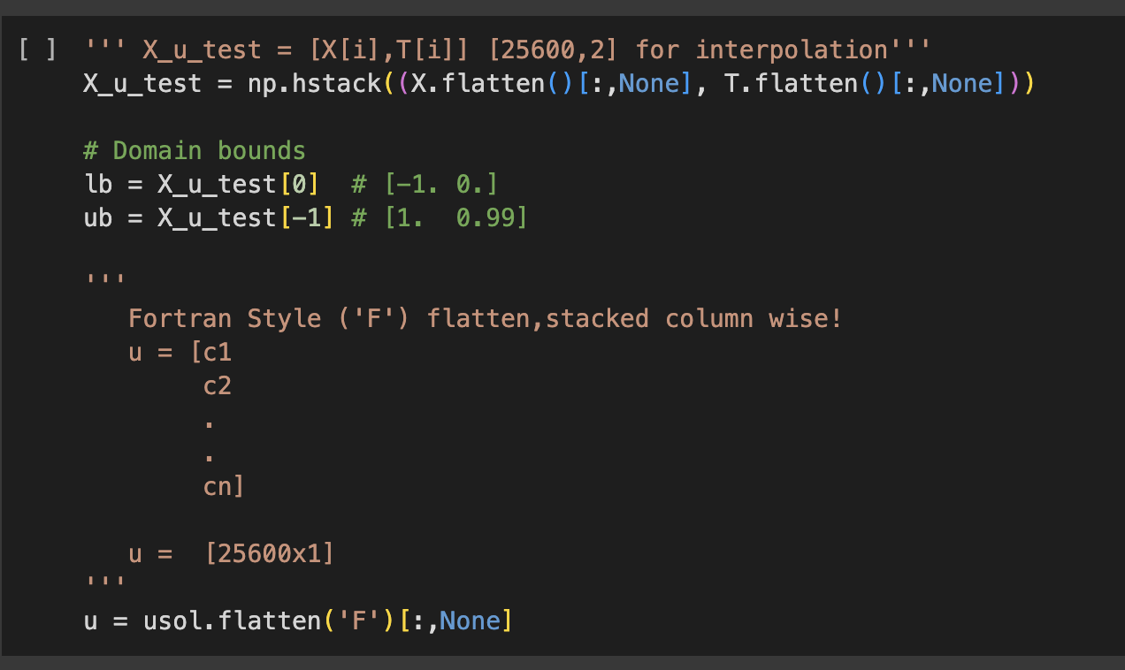
2)Data Preparation:
Generating mesh grid arrays for spatial (x) and temporal (t) coordinates.
Flattening the arrays to create input features for the neural network.
Setting up domain bounds for normalization.

Slide 17
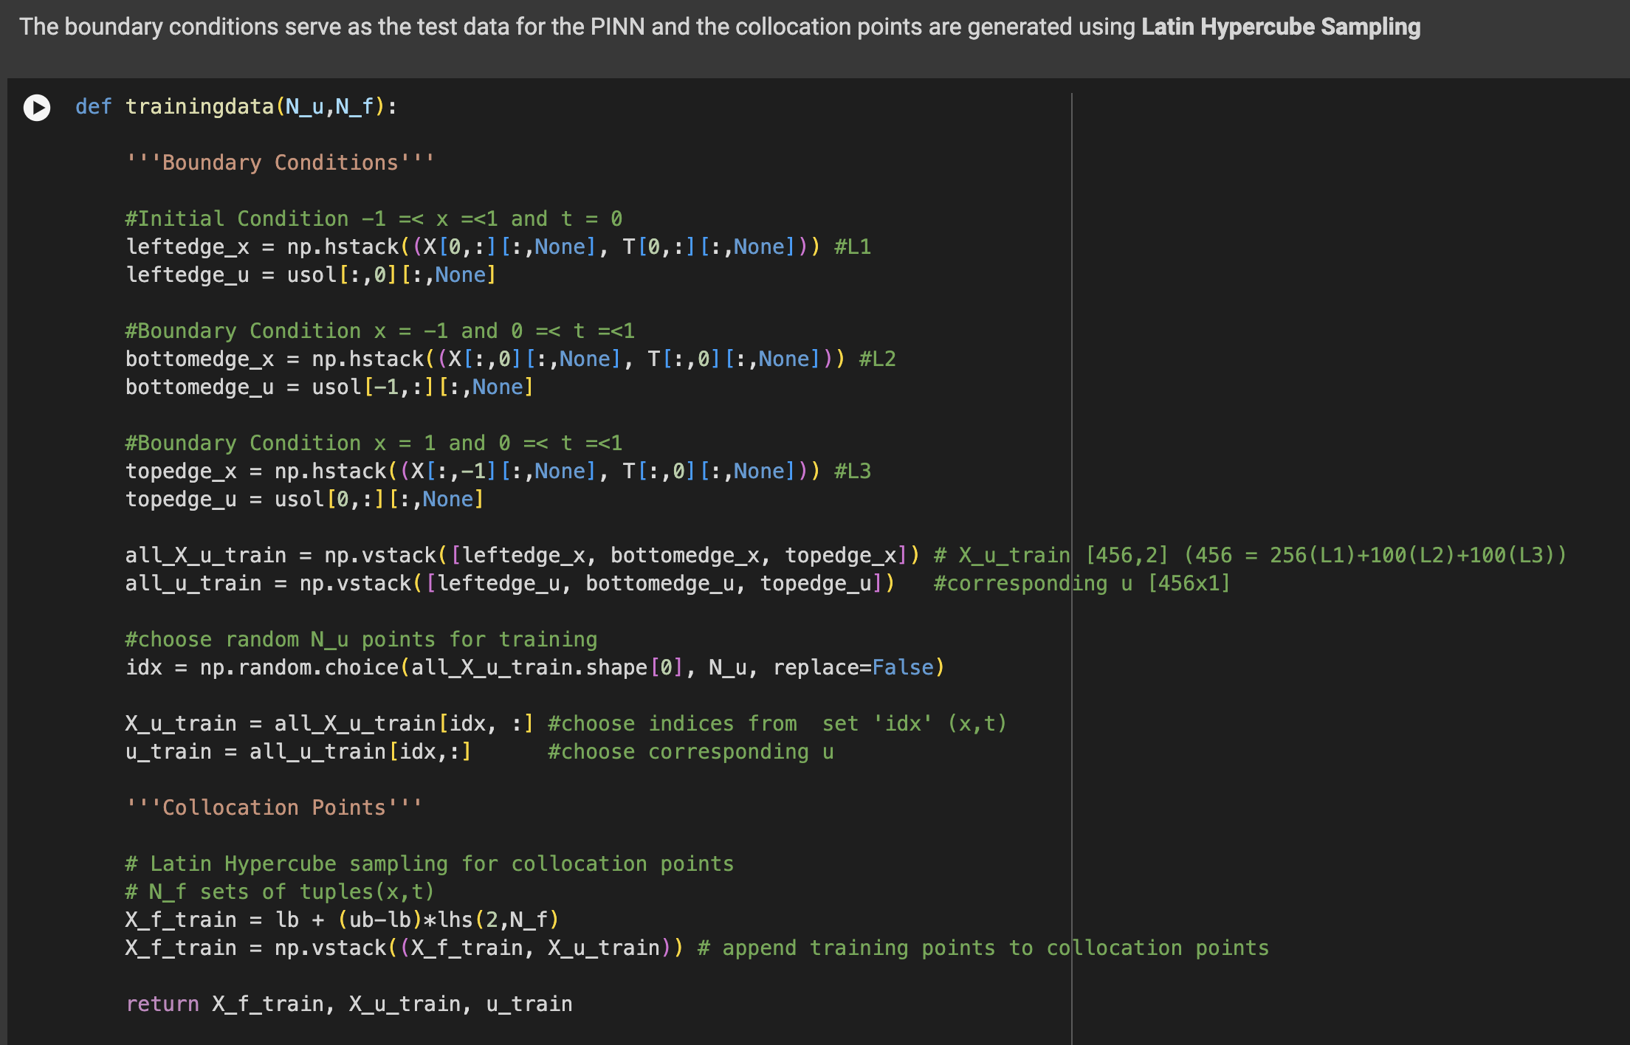
3)Boundary and Initial Conditions Setup:
Defining boundary conditions for the problem.
Organizing data for training including initial and boundary conditions.
Implementing Latin Hypercube Sampling for generating collocation points.

Slide 18
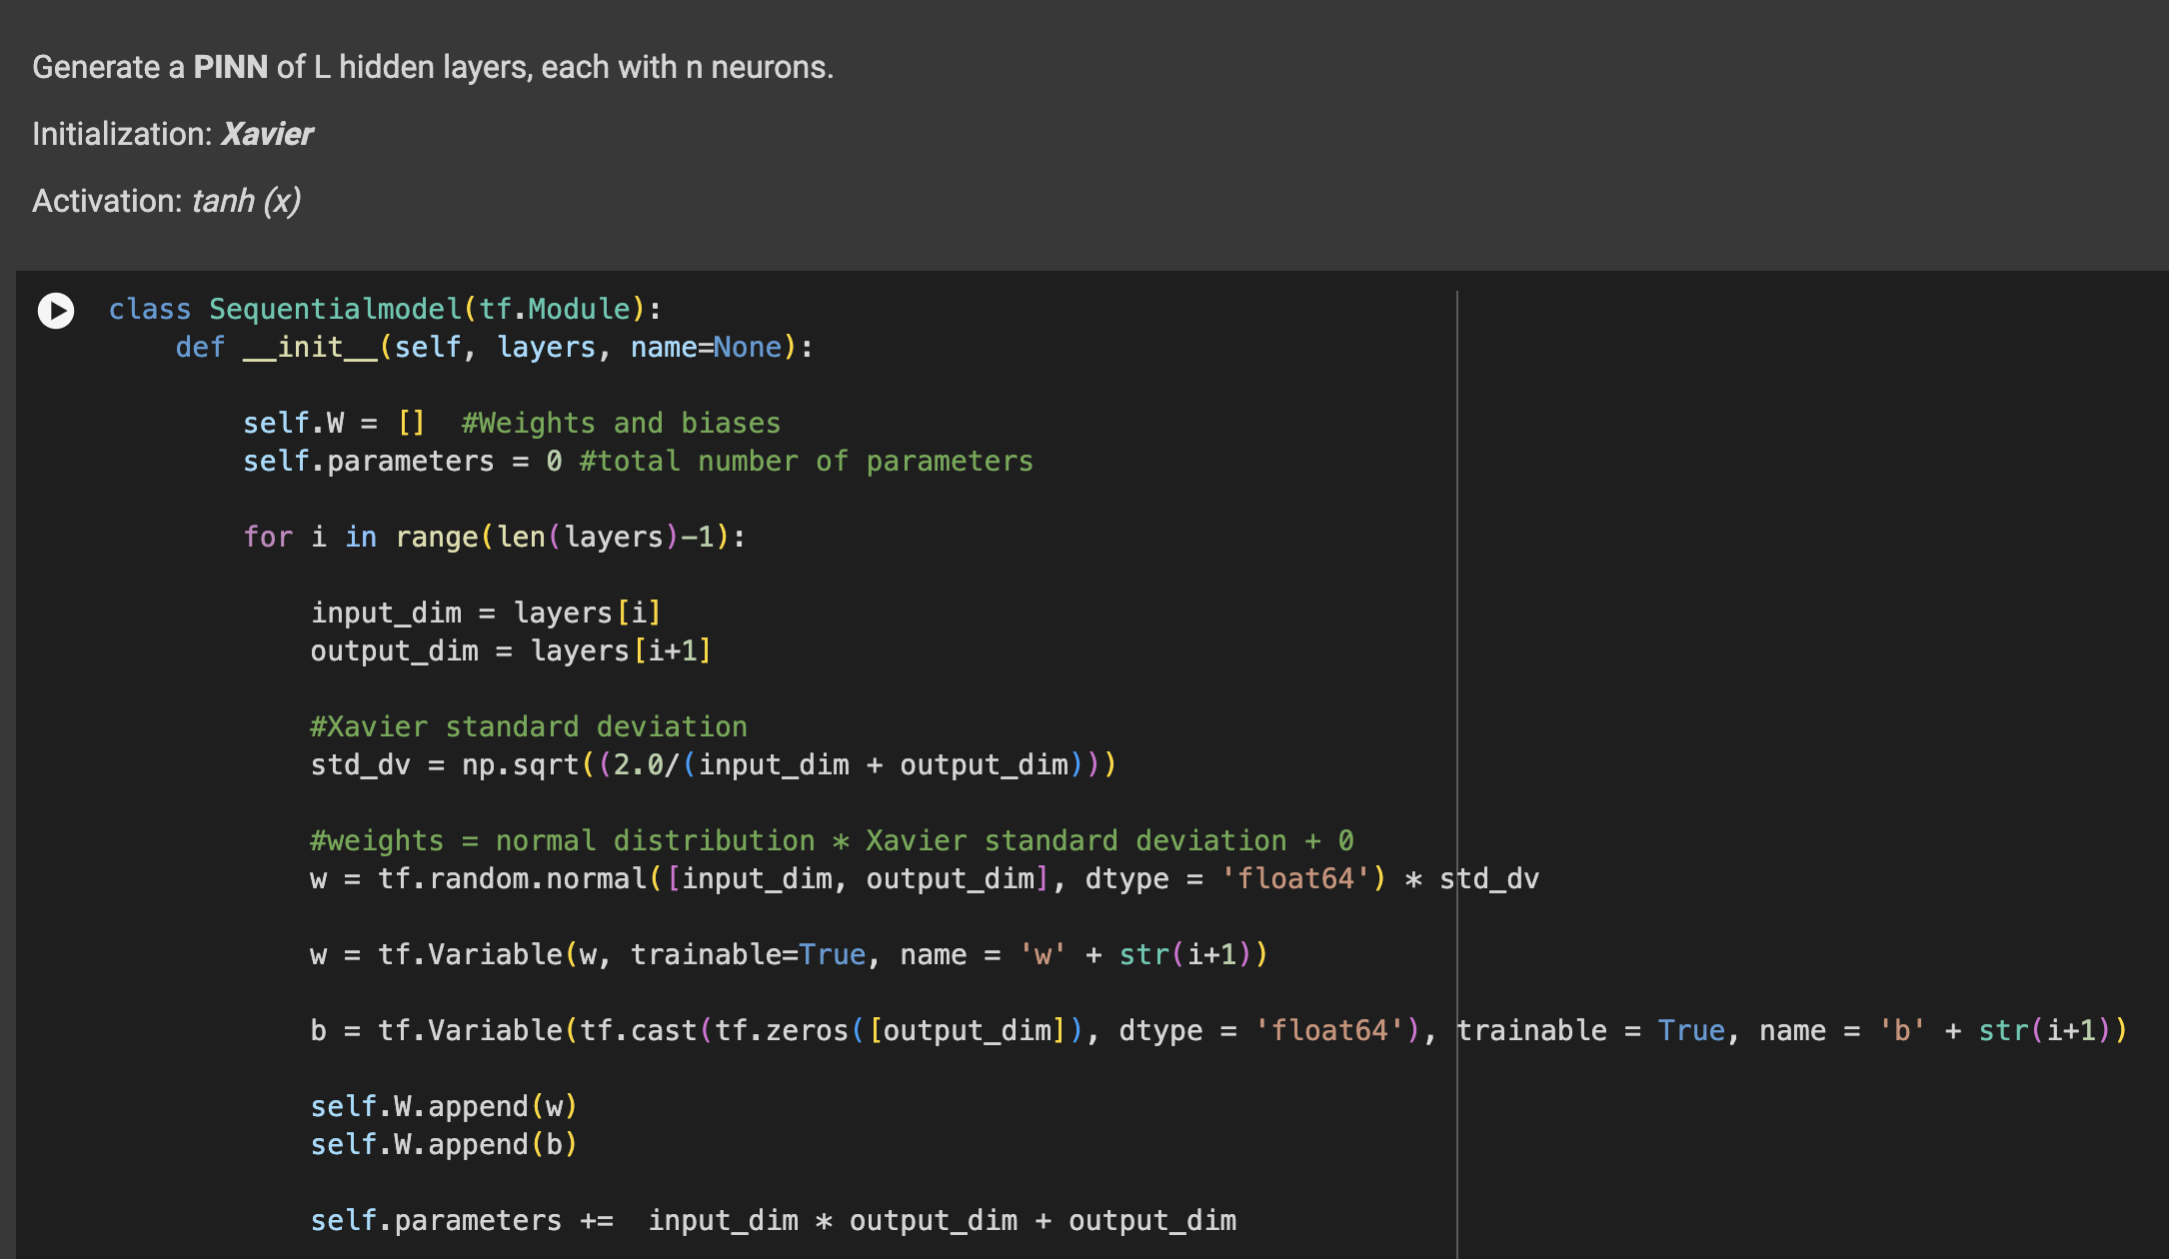
4)Neural Network Model Definition:
Defining the architecture of the Sequential neural network model.
Initialization of weights and biases using Xavier initialization.
Setting up the model's layers and activation functions.

Slide 19
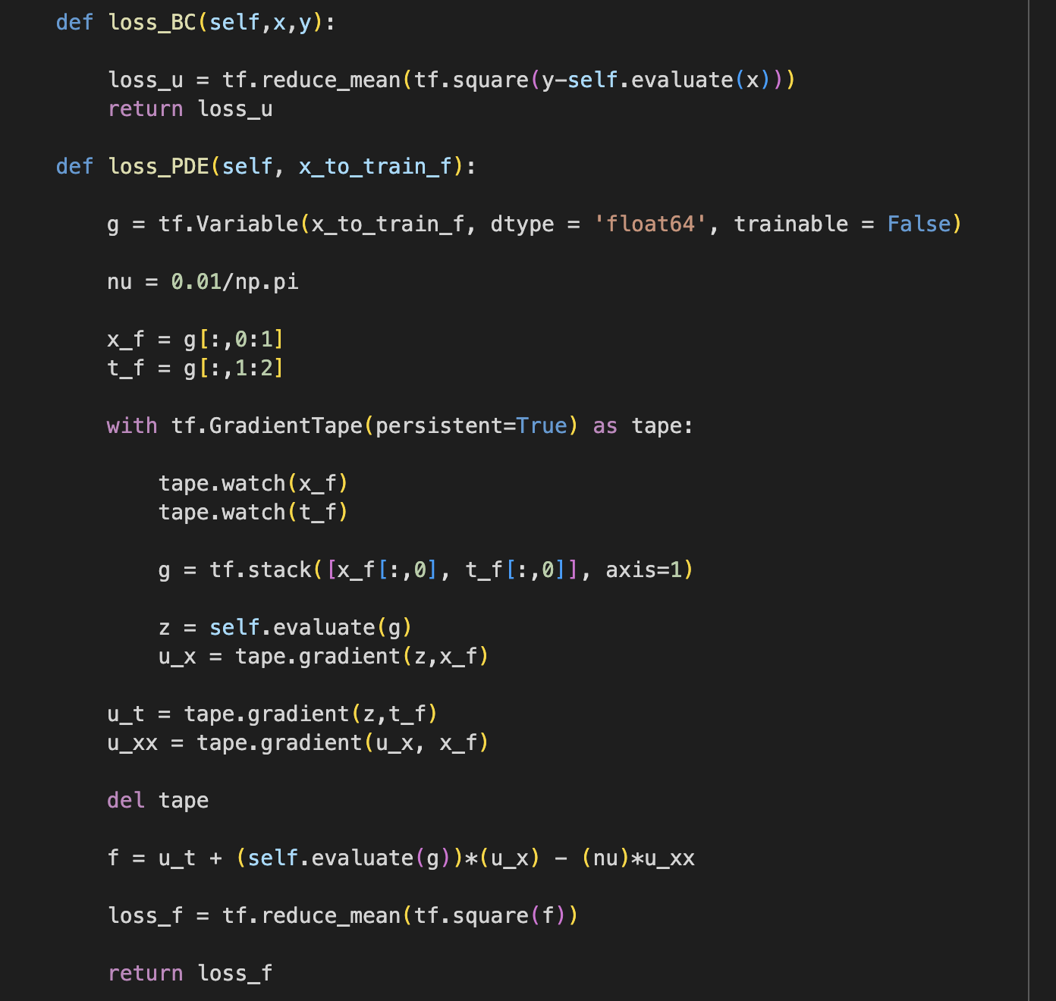
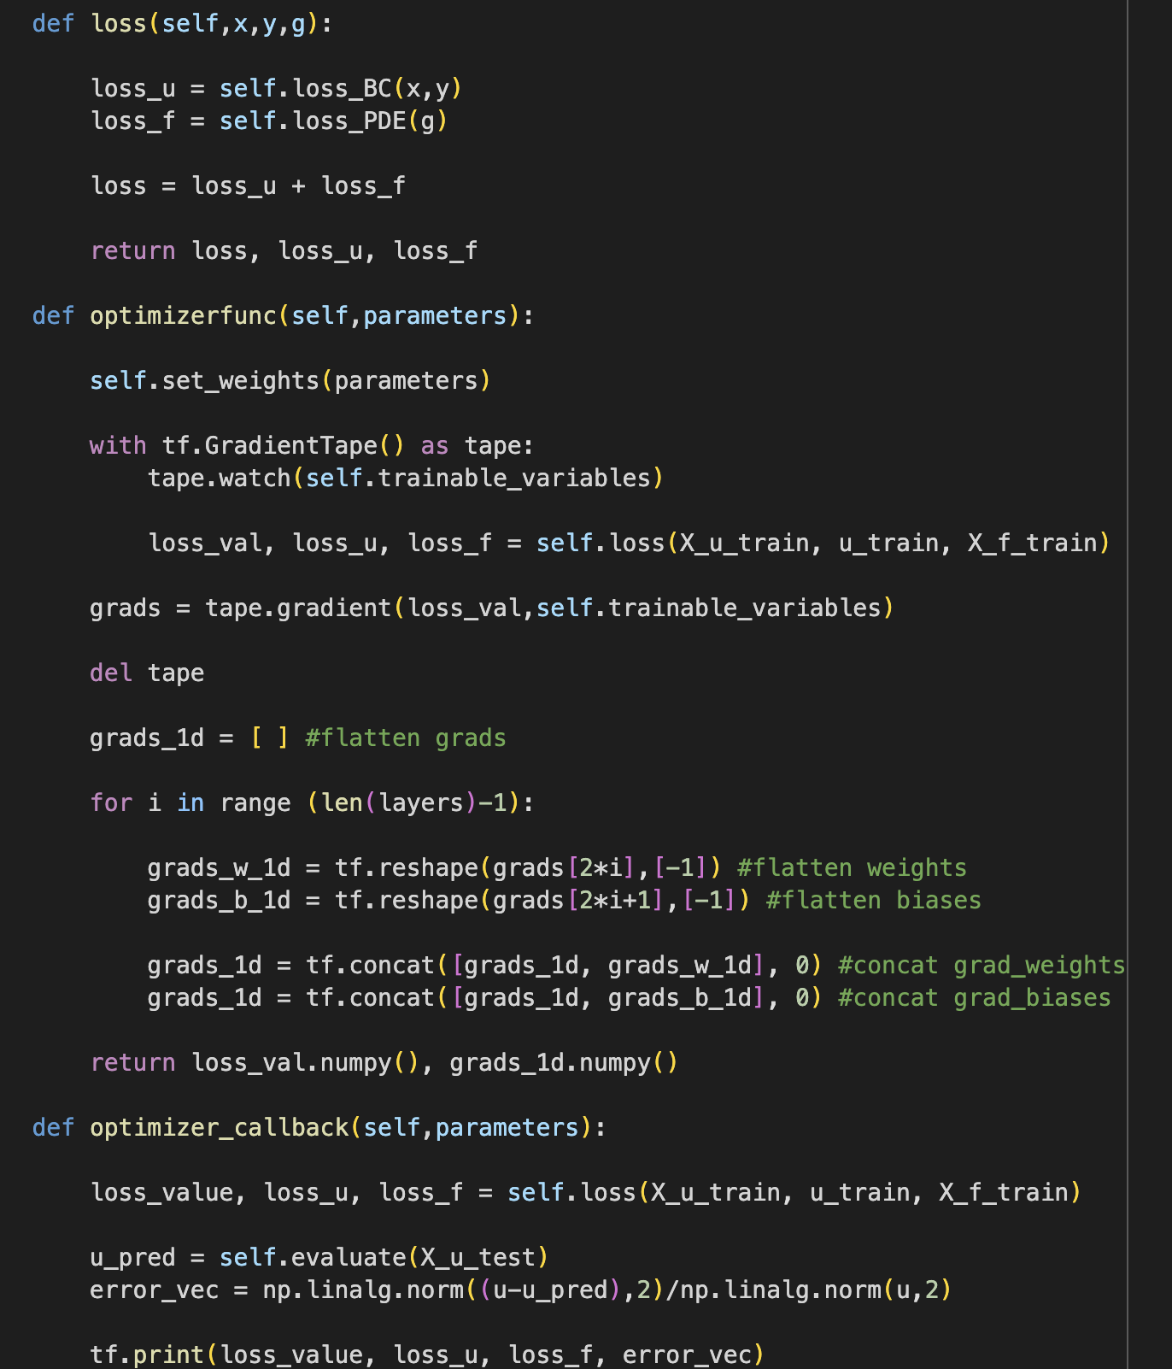
5)Loss Functions and Optimization:
Defining the boundary condition loss and PDE-specific loss functions.
Combining losses for training optimization.

Slide 20
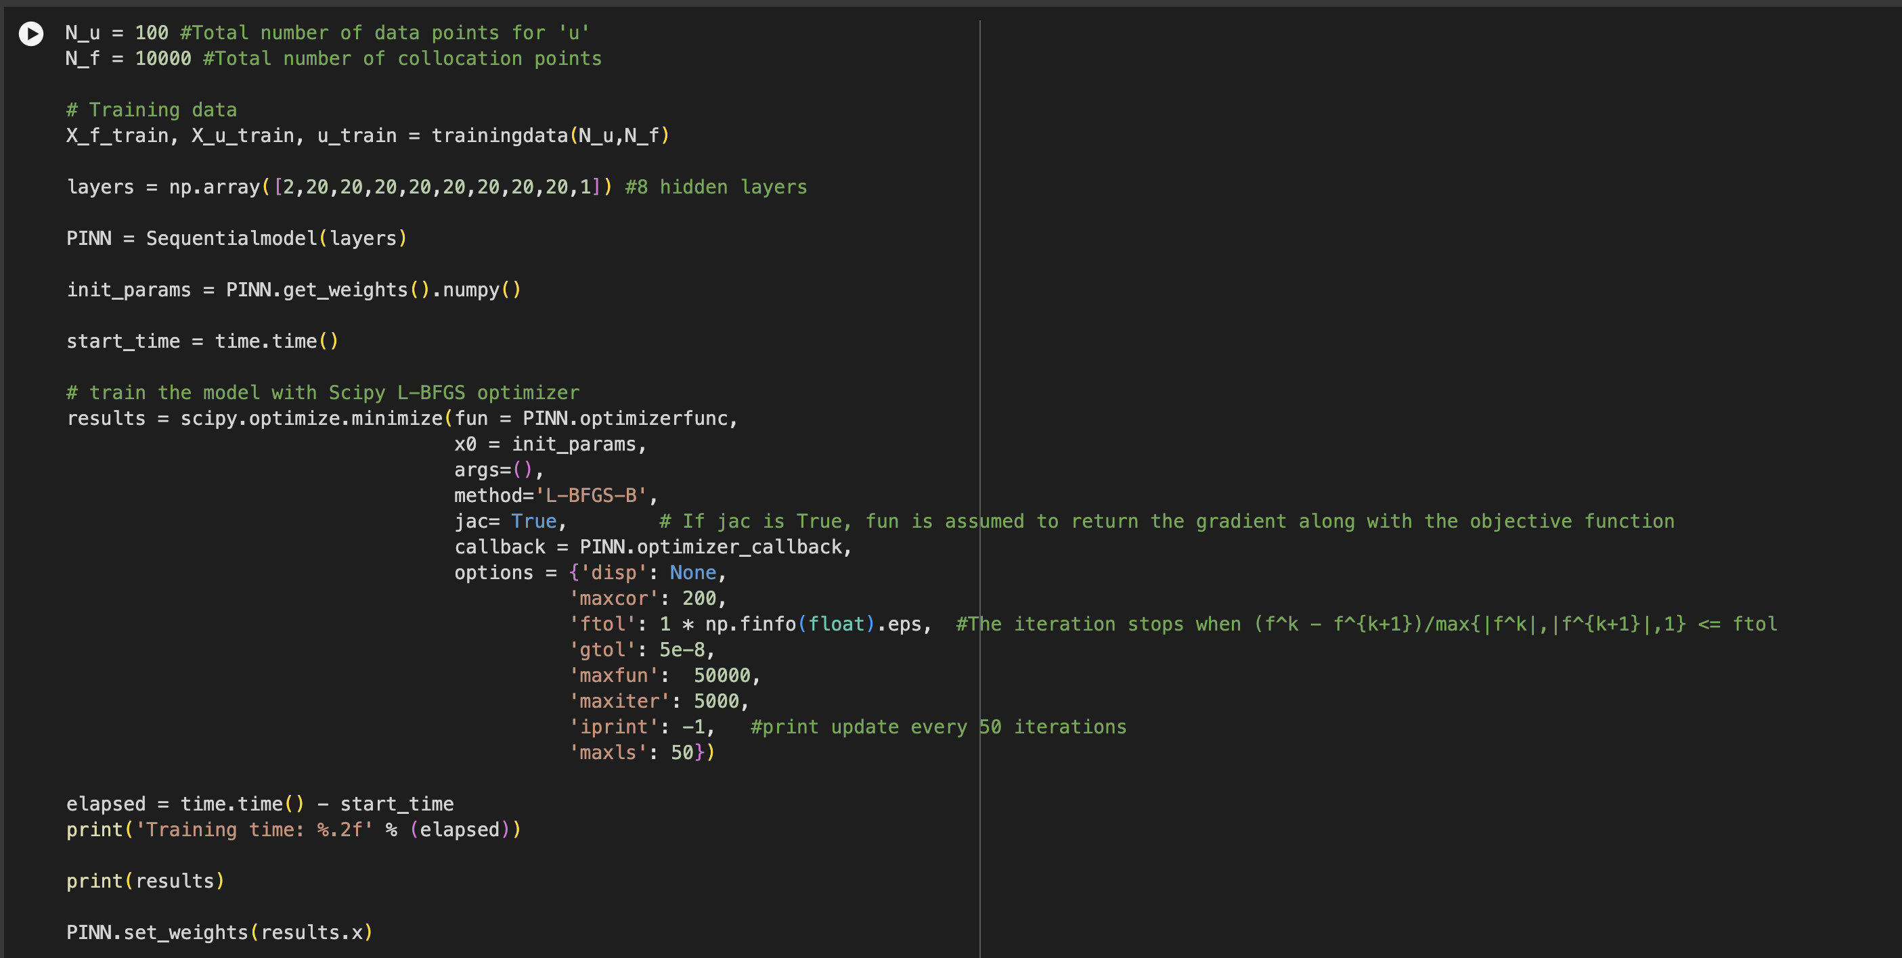
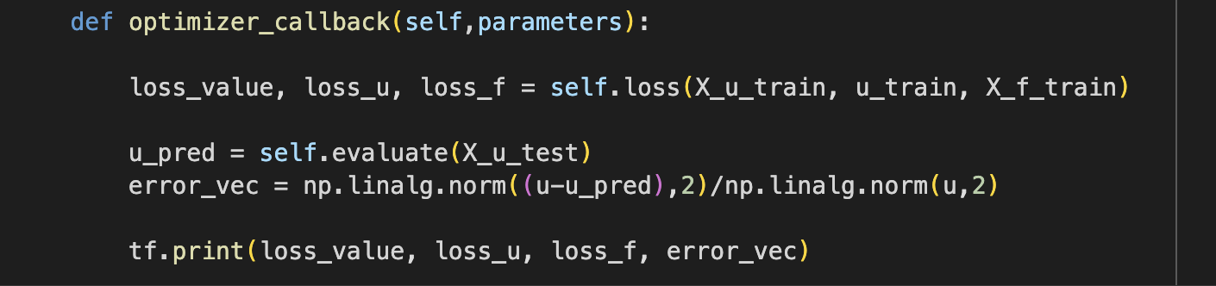
6)Training Process and Callbacks:
Detailed setup for the training process including setting initial parameters.
Setting up the TensorFlow training loop using L-BFGS-B optimizer.
Callback function to monitor training progress and print updates.

Slide 21
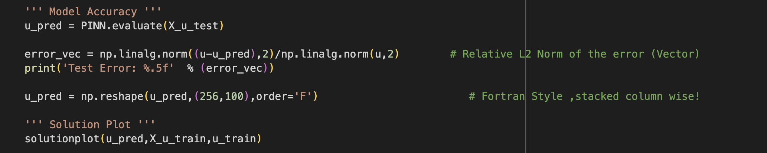
7)Model Evaluation:
Function to evaluate model predictions against actual data.
Plotting solutions and error visualization using Matplotlib.

Slide 22
8)Results:
Training Duration: 5721.02 seconds ~ 95 minutes
Objective Function Value:
Extremely low final objective function value, indicating close fit to the target Burgers’ Equation.
Test Error Analysis:
Achieved a low-test error (0.00184), demonstrating high accuracy in predictions relative to the actual solutions.
Jacobian and Hessian Analysis:
Minimal changes in the Jacobian at the end of training suggest a small sensitivity to parameter changes.
Used a Hessian approximation for optimization, indicating the approach to manage the curvature of the loss landscape.
Optimization Details:
L-BFGS optimization reached the pre-set maximum of 5000 iterations.
Future adjustments could include increasing iteration limits or optimizing hyperparameters for better convergence.

Slide 23
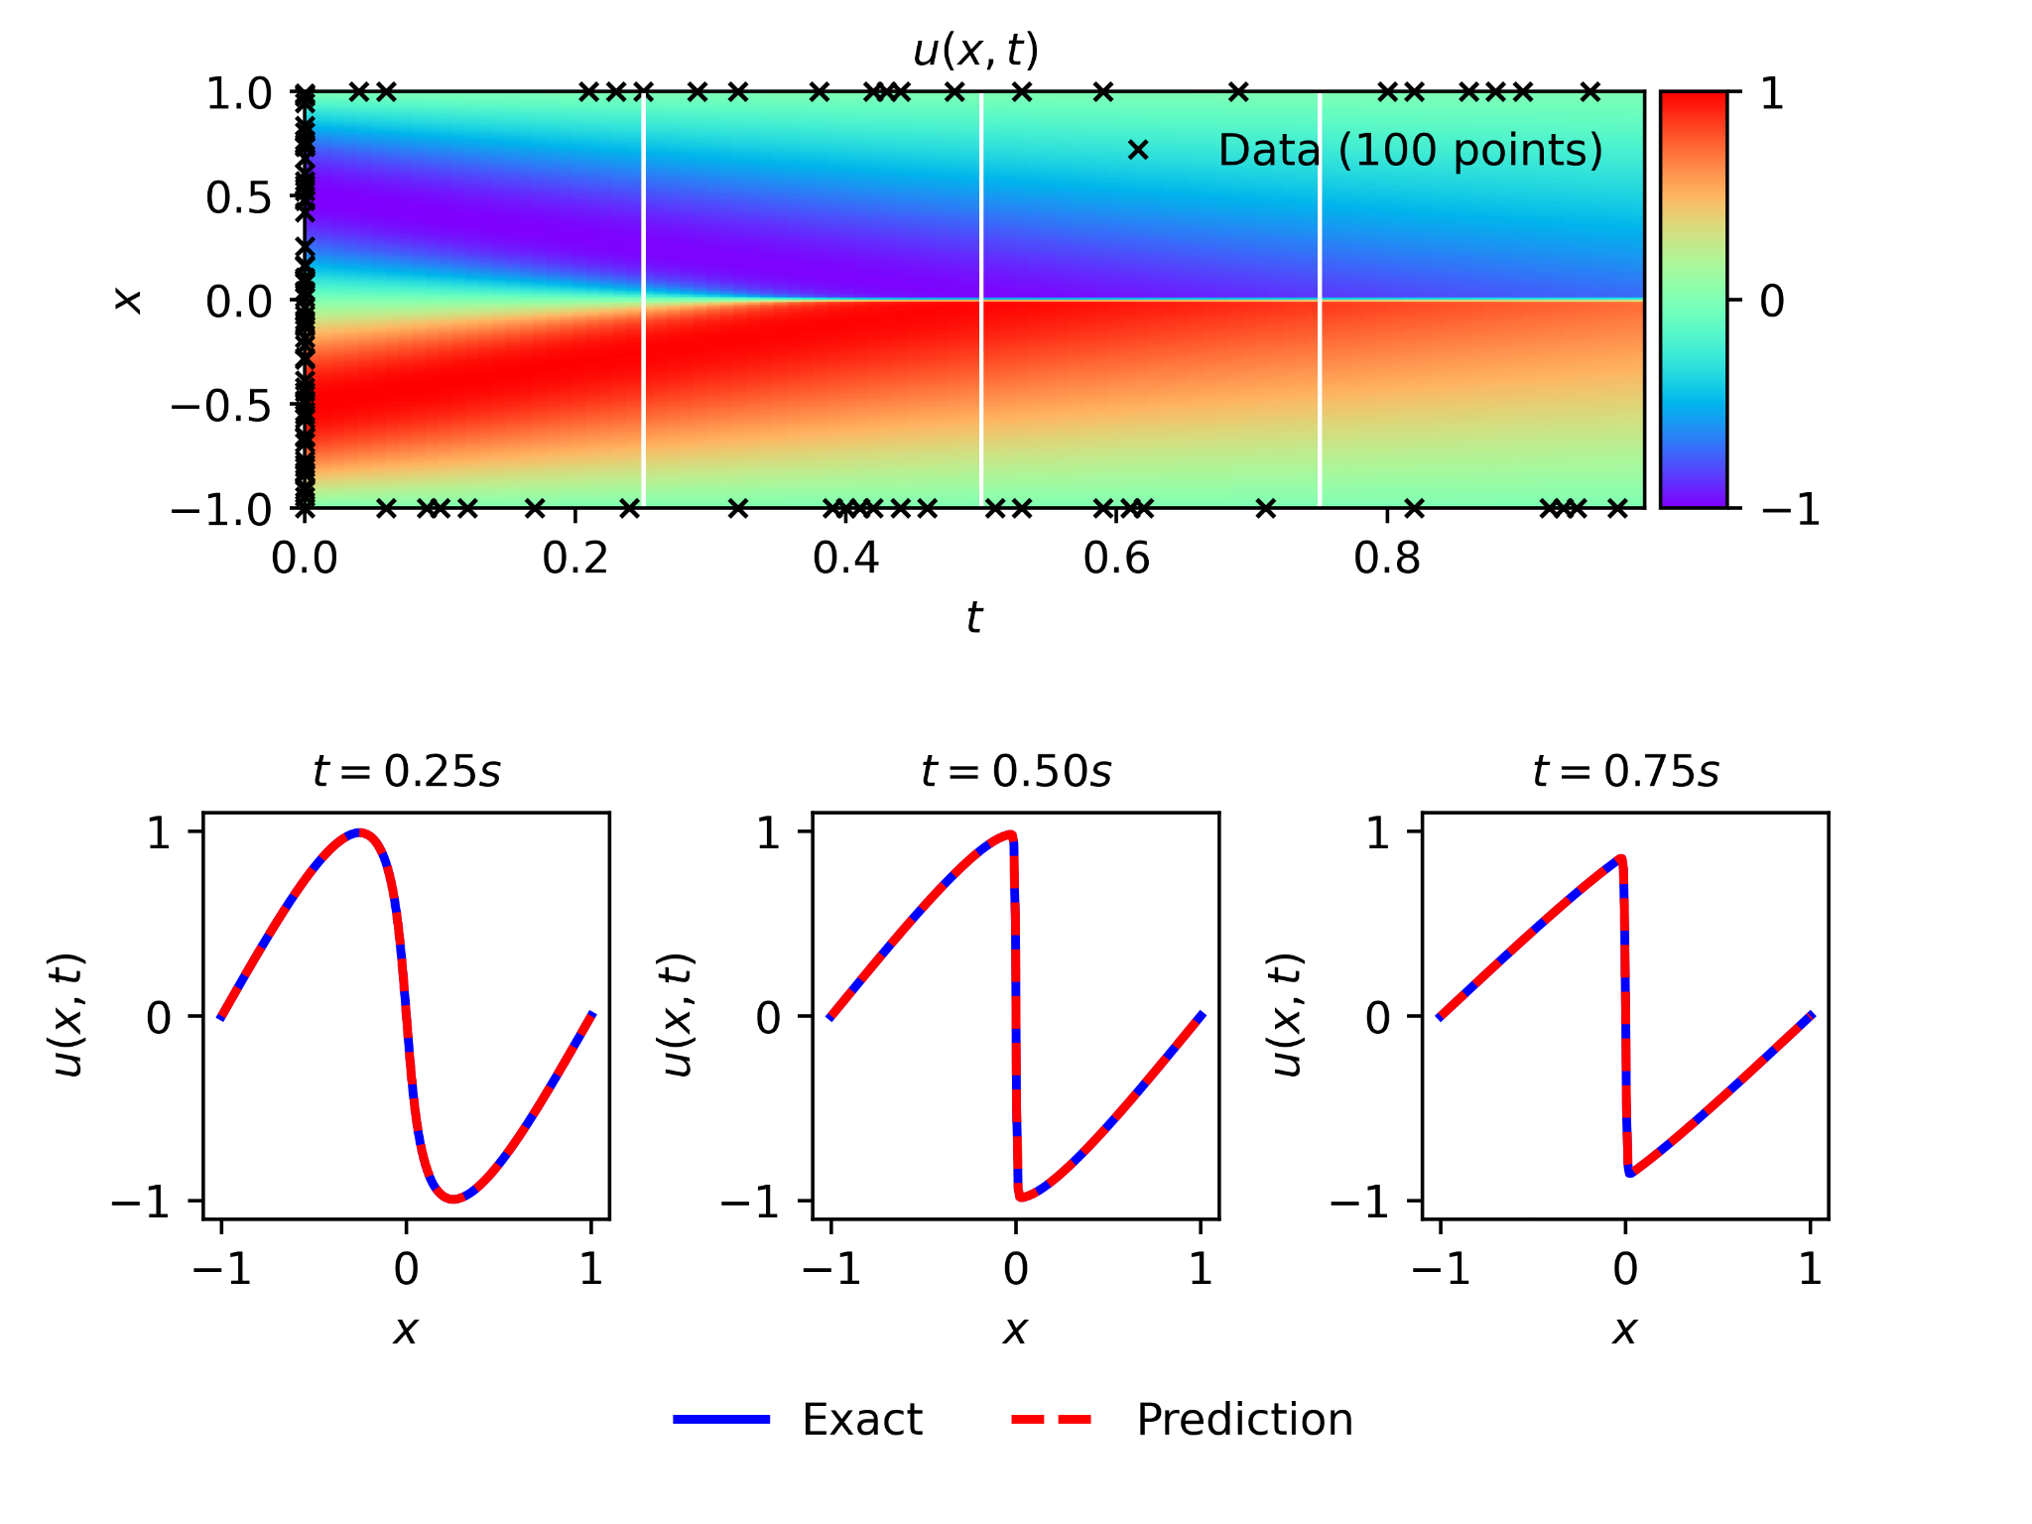
8)Model Visualization:
Model Predictions vs. Exact Solutions"
between PINN model predictions (dashed red line) and exact solutions (solid blue line) for the Burgers' Equation.
Visualization of the model's accuracy in predicting fluid velocity at different time snapshots (0.25s, 0.50s, 0.75s).
The color map in the background shows the velocity field evolution over time and space, with training data points overlaid as black crosses.
The close alignment of the prediction and exact curves demonstrates the PINN's effectiveness.

Slide 24
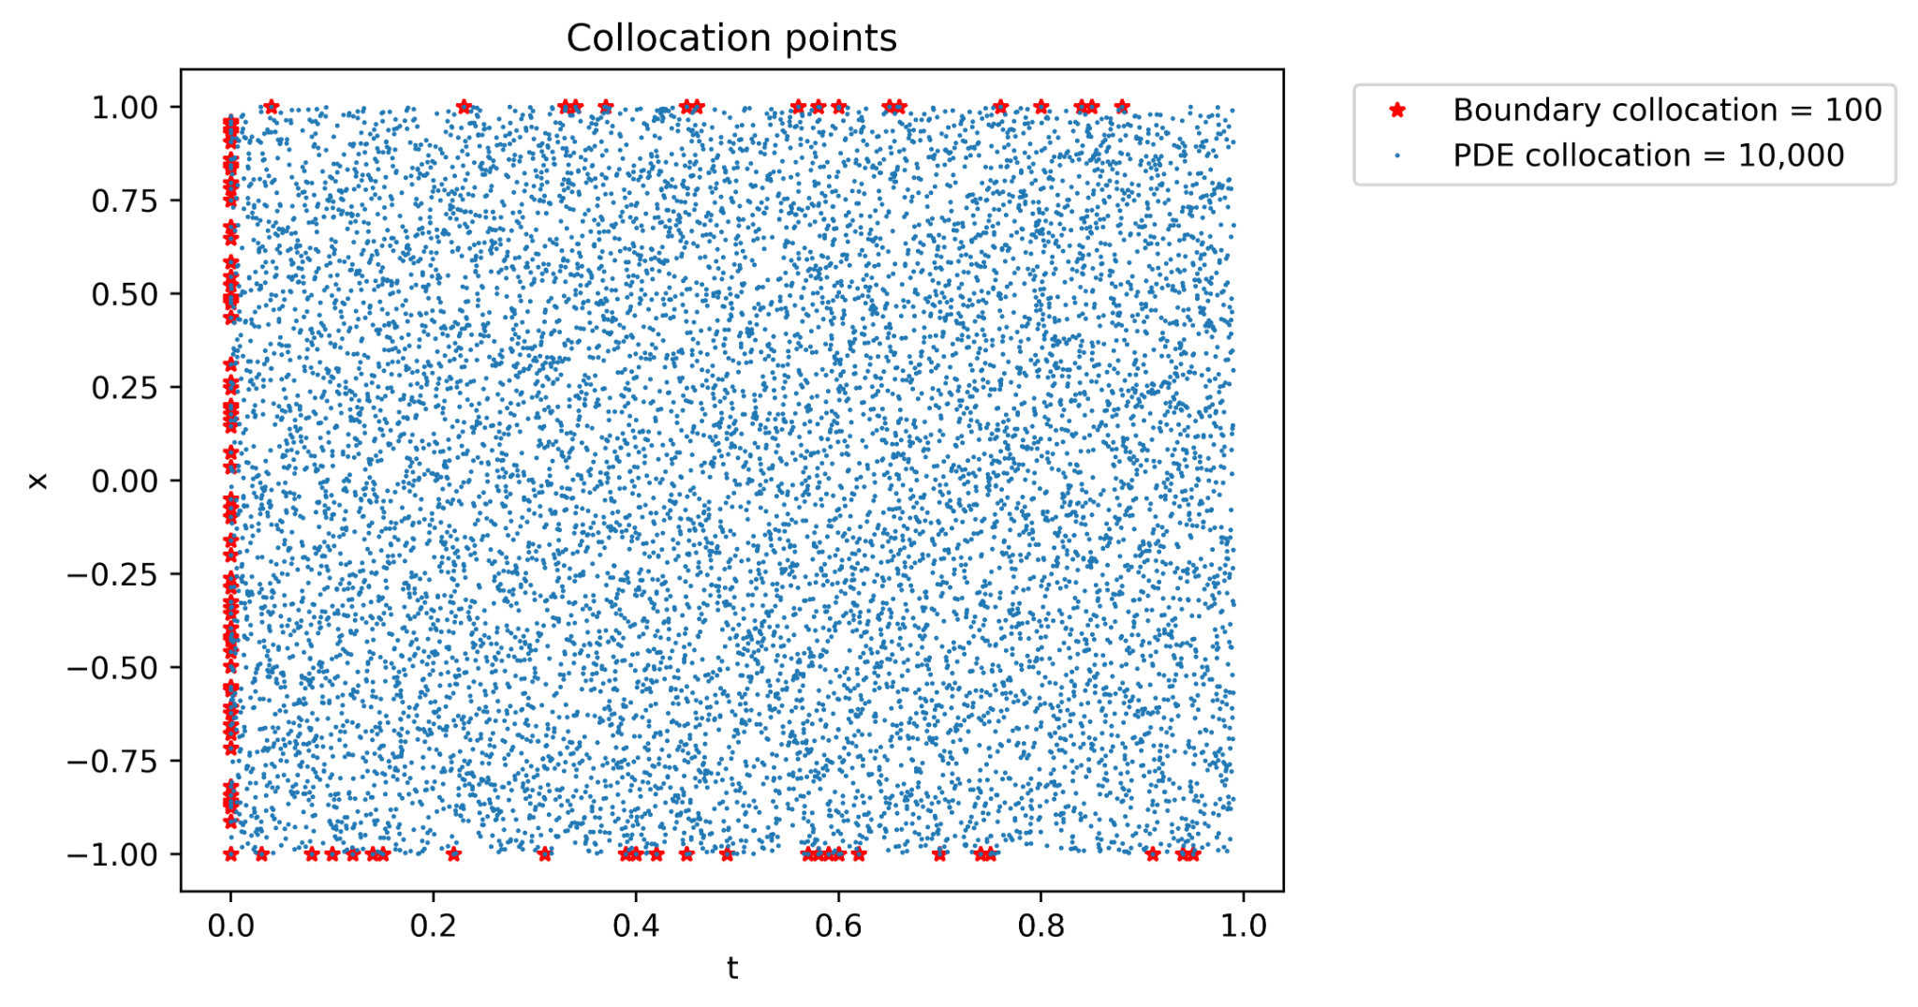
Cont…
2.Training Data and Collocation Points Distribution:
Overview of the training and collocation points used in the PINN model.
Red stars indicate boundary collocation points (100 points) where the model learns boundary conditions.
Blue dots represent PDE collocation points (10,000 points) enforcing the Burgers' Equation throughout the domain.
The distribution of points reflects a strategy for comprehensive domain coverage, ensuring the accuracy of the model's learning.

Slide 25
Challenges:
1. Complexity: The equation's complexity made it hard to get stable and accurate results.
2. Sensitivity: Tiny changes in the starting conditions greatly affected the outcomes.
3. Viscosity Effects: It was tricky to properly include the effects of viscosity in the model.
4. Computational Needs: The model required a lot of computer power, which was a big challenge.
5. Convergence: Getting the model to converge and find solutions was tough.
6. Physical Laws: Making sure the model correctly followed physical laws was difficult.
7. Overfitting: The model often fits too closely to the training data, making it less accurate on new data.
8. Scaling Up: It was hard to expand the model to handle more complex or larger problems.

Slide 26
Discussion:
Analyze the high accuracy of the model and what this means for solving nonlinear PDEs in fluid dynamics.
Discuss the efficiency of the model in terms of computation time compared to traditional numerical methods.
Reflect on the limitations encountered, such as potential overfitting, underfitting, or the need for extensive training data.
Propose further studies to test the model against more complex equations and in higher dimensions.
Suggest exploring alternative deep learning architectures and comparing their performance with the current model.
Highlight the potential of PINNs in other fields of physics or engineering where PDEs are prevalent.
Emphasize the importance of interdisciplinary collaboration to enhance model understanding and application.

Slide 27
Conclusion:
The PINN model successfully integrated physical laws with deep learning to solve the Viscous Burgers' Equation.
Demonstrated high accuracy in prediction, with potential implications for real-world fluid dynamics problems.
The method shows promise for addressing complex PDEs that are challenging for traditional numerical solvers.
Future work could extend this approach to multi-dimensional and more complex fluid dynamics equations.
Collaboration with domain experts in fluid dynamics can further refine the model and expand its application scope.

Slide 28
Acknowledgment:
Special thanks to Dr. Jiaqi Gong, whose guidance and expertise were invaluable throughout this project.
Furthermore, I wish to thank Shakeel Ahmad, a Ph.D. Candidate in the Department of Physics, for his invaluable assistance in explaining the physics part involved in this project.
I am also grateful for the assistance and insights provided by online resources, especially in the areas of neural network tuning and problem-solving.

Slide 29
References:
S. Alkhadhr and M. Almekkawy, ”A Combination of Deep Neural Net- works and Physics to Solve the Inverse Problem of Burger’s Equation,” 2021 43rd Annual International Conference of the IEEE Engineering in Medicine Biology Society (EMBC), Mexico, 2021, pp. 4465-4468, doi: 10.1109/EMBC46164.2021.9630259.
M. Raissi, P. Perdikaris, and G.E. Karniadakis, “Physics-informed neural networks: A deep learning framework for solving forward and inverse problems involving nonlinear partial differential equations,” Journal of Computational Physics, vol. 378, pp. 686–707, 2019.
H. Xu, D. Zhang, E. Song, and X. Luo, “A comprehensive review of physics-informed neural networks in computational fluid dynamics,” Journal of Fluids Engineering, vol. 143, no. 1, 2020.
L. Lu, X. Meng, Z. Mao, and G.E. Karniadakis, “DeepXDE: A deep learning library for solving differential equations,” SIAM Review, vol. 63, no. 1, pp. 208–228, 2021.
L. Ladicky, S. Jeong, B. Solenthaler, M. Pollefeys, and M. Gross, “Data- driven fluid simulations using regression forests,” in Proceedings of the 28th International Conference on Neural Information Processing Systems, vol. 2, pp. 1487–1495, 2015.

Slide 30
Thank you☺☺!!!

